Slide 1

Alfred Investment Company
Team Alfred
1 August 2021

Slide 2

Context
As an investment management company, we provide solutions to clients to invest their money in different financial instruments
AIC has been tasked with developing an analytics-based product that helps determine a truly diversified combination of financial instruments for our clients
Notes:
Investment management company -> different portfolios according to the client base
Meant for leadership team
Have been tasked to develop an analytics-based tool for our portfolio managers who are currently doing their work manually

Slide 3
A paradigm shift in investment portfolio management
Passive portfolio management is in nascent stage, and the market is fragmented
Customers with limited knowledge about the financial investing world want to invest
Potential for new market entrants to provide analytics-based solutions
To achieve their financial goals without having to think about what an optimal investment strategy would be according to their risk profile survey
Key Current Conditions
People with different risk personas interested in investing in instruments that give the highest returns
Brick and mortar banks are in decline, pandemic only exacerbated this trend
This can be achieved by investing a single fund or a combination of different funds
Additional resource hiring to have a direct impact on other support functions such as HR, Finance, Compliance, Audit, etc.
Notes:
Passive portfolios -> invest and forget
Investment suggestions by bots/automated tools
Low/less knowledge people can also invest with help
With pandemic -> physical interaction reduced
Different risk profiles – one size doesn't fit all -> tailored solutions

Slide 4
Our typical customer’s profile and need
Based on the personalized survey, we get the following profiles that identify each customer’s risk appetite
Risk Seeking – High risk tolerance
Risk Neutral – Moderate to low risk tolerance
Risk Averse – No risk tolerance
Open to accept a negative return
Open to have a minimum return as 0
Unwilling to accept a negative return
Post-survey: we identify clients' goals and investment horizons
As per each customer's risk profile, we find the maximum optimal expected returns and suitable mutual funds

Slide 5
Asset Allocation Model Approach (1/2)
Asset Allocation Model
Inputs
Definition
Scenario
Constraint
Result / Outcome
Historical returns for past 5 standalone years
Minimum return that the customer is expecting
Probabilities of each of the potential returns for years 1 to 5
Creating scenarios using historic data
Percentage return
Data on the returns for the five 1-year periods for 5 types of mutual funds
Provide the appropriate constraints to optimize the model
Analysis of the proportion to invest
Scenarios for the next 5 years for the 1-year periods
Year/Mutual Fund | # | Probabilities | Large Cap Equities (LCE) | Mid Cap Equities (MCE) | Balanced Equities (BE) | Fixed Income (FI) | Balanced Funds (BF)
Scenario 1 / Year 1 | S1 | 0.20 | 18.90 | 31.67 | 35.20 | 7.62 | 13.16
Scenario 2 / Year 2 | S2 | 0.35 | 38.20 | 25.20 | 21.90 | 12.60 | 8.54
Scenario 3 / Year 3 | S3 | 0.15 | -14.62 | -30.10 | 30.80 | 4.80 | 2.46
Scenario 4 / Year 4 | S4 | 0.20 | 24.85 | 14.70 | 6.61 | 3.12 | 9.90
Scenario 5 / Year 5 | S5 | 0.10 | -0.98 | 4.81 | -8.12 | 9.18 | -3.49
All numbers are in %
Notes:
Now we have the risk profile
Now we can do it through LP to automate and introduce analytics
4-5 major requirements Referred -> Fidelity.ca

Slide 6
Asset Allocation Model Approach (2/2)
Decision Variables
Proportion to invest for each type of mutual fund LCE, MCE, BE, FI, BF
Objective Function
Returns from each scenario is a product of yearly returns from the fund type:
S1 = 18.90 * LCE + 31.67 * MCE + 35.20 * BE + 7.62 * FI + 13.16 * BF
S2 = 38.2 * LCE + 25.2 * MCE + 21.9 * BE + 12.6 * FI + 8.54 * BF
S3 = -14.62 * LCE + 30.1 * MCE + 30.8 * BE + 4.8 * FI + 2.46 * BF
S4 = 24.85 * LCE + 14.7 * MCE + 6.6 * BE + 3.12 * FI + 9.9 * BF
S5 = -0.98 * LCE + 4.81 * MCE - 8.12 * BE + 9.18 * FI – 3.49 * BF
Maximize Return = {0.2*S1 + 0.35*S2 + 0.15*S3+ 0.1*S4 + 0.2*S5}
Constraints
Sum of contributions should be equal to 1 - Proportion Constraint => LCE + MCE + BE + FI + BF = 1
Every scenario should give minimum returns as per customer's risk profile – in our model we are evaluating three types of customer profiles (-2%, 1% and 5% returns for each type)

Slide 7
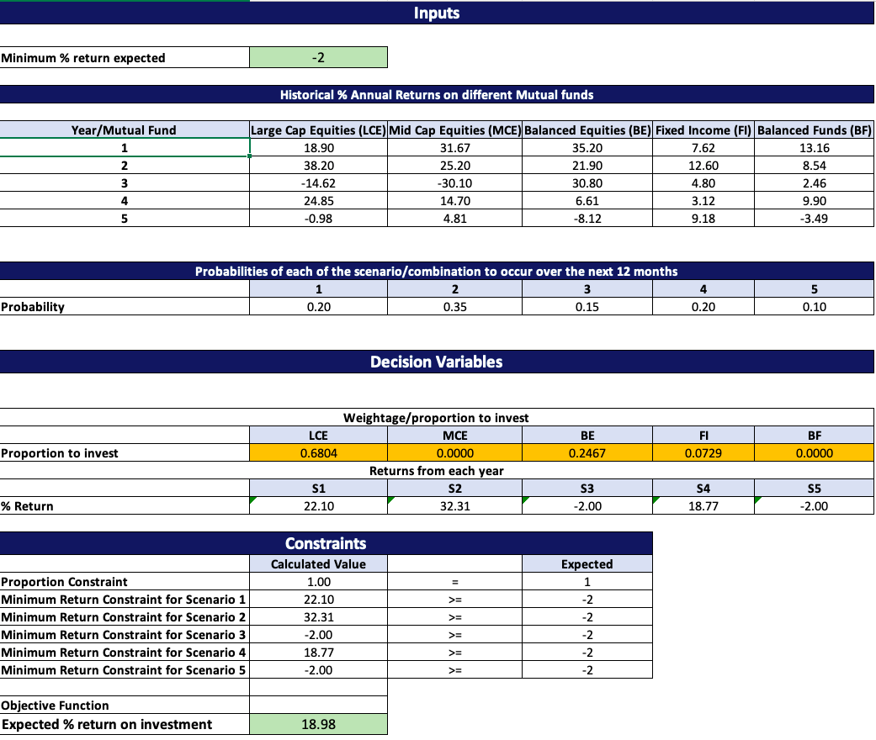
LP model for what to invest in and where to invest!
-2% Return
-1% Return
5% Return
Portfolio | Weight / Allocation
LCE | 68.0% | 46.3% | 17.5%
MCE | 0 | 0 | 0
BE | 24.6% | 20.0% | 13.8%
FI | 7.2% | 33.5% | 68.6%
BF | 0 | 0 | 0
Expected ROI (%)​ | 18.9 | 15.9 ​ | 11.5
Scenario | -2% Return | 1% Return | 5% Return
S1 (20%) | 2.10 | 18.38 | 13.42
S2 (35%) | 32.31 | 26.34 | 18.38
S3 (15%) | -2.00 | 1.00 | .00
S4 (20%) | 18.77 | 13.90 | 7.41
S5 (10%) | -2.00 | 1.00 | 5.00
Expected % ROI | 18.98 | 17.32 | 12.59

Slide 8
Benefits of analytics-based solution in the investment market
Potential Future
Current
Basic Scenario Based Model
Robust & Effective Model
Assumptions
Manual & Experienced Based
Linear programming based
Simulation based linear programming
New product innovation
`
Yearly returns are approximations based on data derived from Fidelity.ca
Years are independent and discrete
The probabilities used are assumptions by the portfolio managers about the next 12 months
Personalization of the investment per customer profile
Susceptibility to accommodate changes in the financial market
Notes:
Notes: (includes regulatory, mandatory, addition of new companies and so on

Slide 9
Limitations in the current devised model
Investment companies cannot provide guarantee on returns, as this is a highly experience-driven industry
The industry is vast, and it is very difficult to consolidate and synthesize data manually
It does not account for the yearly inflation
The model does not incorporate the simulation model that helps us find the distribution of the returns

Slide 10
Way forward
1
Add the distribution of returns to build the simulation-based model
2
Diversification of fund options to build more scenario
3
Pilot testing of the MVP

